Slide 1
Public Hearing: Current Agricultural Use Values (CAUV)
Tax Year 2024 – Proposed Final Values
Division of Tax Equalization
July 12, 2024

Slide 2
Meeting Purpose & Agenda
Purpose: This is a public hearing before the Ohio Department of Taxation to present data on the proposed final Current Agricultural Use Values (CAUV) for tax year 2024.
Agenda:
Data Sources
CAUV Formula
Formula Inputs
Sample Calculations
Year-to-Year Comparisons
Questions & Comments

Slide 3
CAUV FORMULA
Data sources & formula inputs

Slide 4
CAUV Formula
GOI = Crop Yield x Average Crop Price
NOI = GOI – Non-land Production Costs
Value = NOI/Capitalization Rate
Factors used in the CAUV Calculation
Income Factors: Crop yields, crop prices, and cropping patterns
Expense Factors: Non-land production costs
Capitalization rate for net income

Slide 5
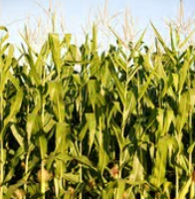
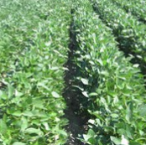
Cropping Yields & Cropping Patterns
Soil yields from 1984:
Adjusted by 10-year average of actual yields per acre for 2014-2023.
Single crop pattern for most soils based on five-year average of acres harvested, 2019-2023:
Corn 37%
Soybeans 57%
Wheat 6%
Maintain 50% corn and 50% soybeans for organic and frequently flooded soils.

Slide 6
Crop Prices Used in Five Year Average
USDA, National Agricultural Statistics Service Crop Values, 2023 Summary, February 2024
Crop Year | Corn | Soybeans | Wheat
2023 | $4.60 | $12.60 | $6.30
2022 | $6.28 | $14.40 | $7.85
2021 | $5.92 | $13.60 | $6.49
2020 | $4.69 | $11.30 | $5.27
2019 | $3.91 | $9.04 | $5.22
2018 | $3.74 | $8.69 | $5.08
2017 | $3.61 | $9.62 | $4.90

Slide 7
Adjusted Crop Prices in the Formula, 2021-2024
USDA, National Agricultural Statistics Service 2023 Summary, February 2024
 |  |  |  | Variance
 | 2021 | 2023 | 2024 | 2021 – 2024 | 2023 – 2024
Corn | $3.59 | $4.21 | $4.40 | $0.81 | $0.19
 |  |  |  | 22.56% | 4.51%
Soybeans | $9.10 | $10.22 | $10.81 | $1.71 | $0.59
 |  |  |  | 18.79% | 5.77%
Wheat | $4.76 | $5.20 | $5.52 | $0.76 | $0.32
 |  |  |  | 15.97% | 6.15%

Slide 8
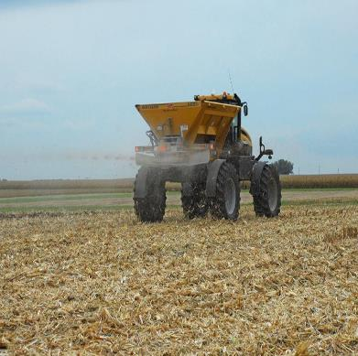
Non-land Production Cost Base & Added Unit
2021 – 2024
USDA, National Agricultural Statistics Service Crop Values, 2023 Summary, February 2024
 |  |  |  | Variance
 | 2021 | 2023 | 2024 | 2021-2024 | 2023-2024
Corn | $491.35 | $509.17 | $530.29 | $38.94 | $21.12
+bu | $1.34 | $1.31 | $1.28 | ($0.06) | ($0.03)
Beans | $322.85 | $323.41 | $333.03 | $10.18 | $9.62
+bu | $0.89 | $1.03 | $1.13 | $0.24 | $0.10
Wheat | $284.91 | $264.36 | $272.17 | ($12.74) | $7.81
+bu | $1.29 | $1.37 | $1.45 | $0.16 | $0.08

Slide 9
Capitalization Rate, Tax Year 2021 & 2024
Farm Credit Services, January – May 2024 USDA Farm Sector Financial Ratios, February 2024
 | 2021 | 2024 | Variance
Mortgage/Equity Ratio | 80/20 | 80/20 | 2021-2024
Interest Rate, 25-Year Fixed
Multi-Flex Loan* | 5.46% | 6.20% | 0.74%
Equity Rate** | 7.21% | 7.75% | 0.54%
Tax Additur | 1.6% | 1.4% | (-0.17%)
Capitalization Rate | 7.80% | 8.20% | 0.40%
*Farm Credit Services, 25-Year fixed multi-flex rate for loan amounts $75,000 and over.
**25-year average rate of total return on farm equity

Slide 10
SAMPLE CALCULATIONS

Slide 11
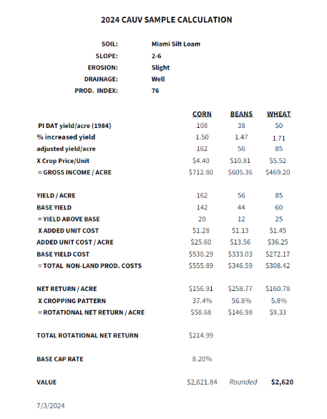
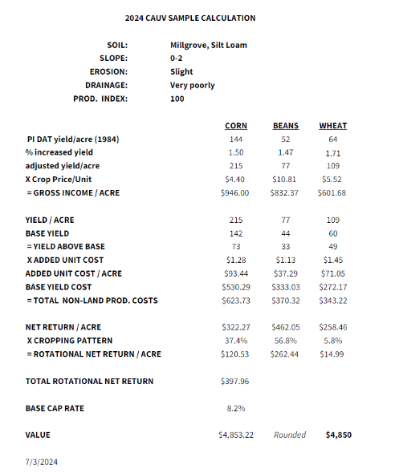
2024 SAMPLE CALCULATIONS

Slide 12
YEAR-TO-YEAR
COMPARISONS

Slide 13
Cropland, Simple Average CAUV Value by Productivity Index
2016 - 2023
Average CAUV Values by Year, 2016 - 2024
Productivity Index |  |  |  |  |  |  |  |  | Proposed Final 2024
 | 2016 | 2017 | 2018 | 2019 | 2020 | 2021 | 2022 | 2023
0-49 | 350 | 350 | 350 | 350 | 350 | 350 | 350 | 350 | 350
50-59 | 466 | 430 | 400 | 378 | 351 | 358 | 409 | 607 | 691
60-69 | 1235 | 1061 | 896 | 731 | 488 | 598 | 915 | 1502 | 1728
70-79 | 2255 | 1969 | 1723 | 1469 | 1073 | 1253 | 1672 | 2364 | 2629
80-89 | 3302 | 2909 | 2586 | 2270 | 1783 | 1969 | 2439 | 3244 | 3548
90-99 | 4074 | 3602 | 3226 | 2863 | 2303 | 2512 | 3007 | 3871 | 4223
100+ | 4750 | 4205 | 3810 | 3420 | 2820 | 2990 | 3550 | 4430 | 4850
Average | 1310 | 1153 | 1015 | 876 | 668 | 759 | 999 | 1443 | 1616
No. of Soils | 3514 | 3514 | 3514 | 3514 | 3514 | 3517 | 3517 | 3517 | 3517

Slide 14
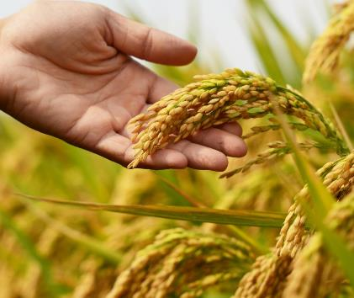
Cropland – Average CAUV Value

Slide 15
Average CAUV (Formula) & Ohio Cropland Value
USDA Dollars per Acre, 2007 - 2023

Slide 16
WOODLAND & CONSERVATION

Slide 17
Average Woodland Value & Conservation
Average Woodland
Conservation
 | 2020 | 2021 | 2022 | 2023 | 2024
Slope of 25% or Less
Maximum | $1,300 | $1,540 | $2,000 | $2,890 | $230
Median | $230 | $230 | $230 | $230 | $230
Average | $250 | $268 | $341 | $600 | $230
Minimum Value: All Slopes
 | $230 | $230 | $230 | $230 | $230
Number of Soils at Minimum Value: Slope 25% or Less
 | 3,263 | 3,125 | 2,662 | 1,849 | 3,517
Land used for conservation practices (25%) or formal agreement with federal government receive:
Lowest value in the table ($230)

Slide 18
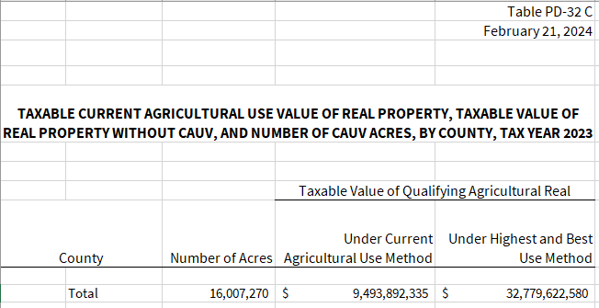
CAUV Program Savings
Source: Ohio Department of Taxation; Taxable Current Agricultural Use Value of Real Property, Taxable Value of Real Property without CAUV, and Number of CAUV Acres, By County, Tax Year 2023; Updated 2/21/2024. https://tax.ohio.gov/static/tax_analysis/tax_data_series/tangible_personal_property/pd32/pd32ty23.xlsx

Slide 19
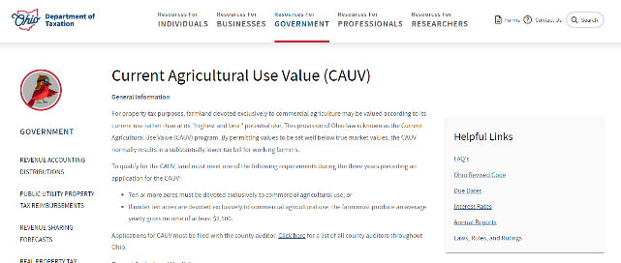
CAUV Information (2009 – 2023) Online
Contact the Department
https://tax.ohio.gov/government/real-state/cauv
Stephanie Stultz-Wynkoop
Stephanie.Stultz-Wynkoop@tax.ohio.gov
(614) 752-8613
Kelly Tennant
Kelly.Tennant@tax.ohio.gov
(614) 466-1799
DTE General Contact Information
DTE@tax.ohio.gov
(614) 466-5744
Questions & Comments
Questions & Comments
QUESTIONS & COMMENTS

